Slide 1
Some like it tough: Improving model generalization via progressively increasing the training difficulty
Hannes Fassold, JOANNEUM RESEARCH
ASPAI 2021 November 17-19, 2021 Online

Slide 2
Introduction & Motivation
Adaptive gradient methods (e.g. Adam) are standard now in training
Advantage: less sensitive to weight initialization and hyperparameter
Disadvantage: do not generalize as well as SGD
Different strategies for increasing generalization capability
Better data augmentation, optimizer, use more data, better learning strategies (e.g. curriculum learning, importance sampling), …
Curriculum learning
Mimicks learning strategy of humans
First learn the “easy” stuff, and later on the more complex / “harder” subjects
Vast research field with a lot of publications / possible strategies

Slide 3
Mini-batch trimming - Idea
A good curriculum strategy is
general – works for all kind of models (CNNs, transformers, GANs, …)
minimally invasive – does not change model & training workflow “too much”
Mini-batch trimming to the rescue
Very simple idea: Calculate the loss for current mini-batch B only from the “harder” (more difficult) samples in the current mini-batch
So the weight update is more focusing on the difficult samples
Take per-sample loss L(s) as estimate of “hardness” of sample s
Fraction p of “hard” samples is linearly decreased during training, so training process gets progressively more difficult
p = 1.0 at begin of training and p = 0.2 at end of training

Slide 4
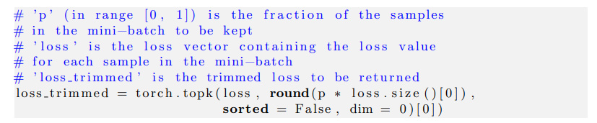
Mini-batch trimming - Implementation
Implementation of mini-batch trimming is very easy
Only the loss calculation has to be changed slightly
Selection of the K values with the highest loss in the mini-batch can be done via pytorch function topk
topk function is differentiable
Pseudo-code

Slide 5
Experiments & Evaluation - Setup
Datasets
3 Standard image classification datasets: SVHN, CIFAR-10 and CIFAR-100
32x32 pixel images
10 classes (SVHN, CIFAR-10) and 100 classes (CIFAR-100)
Networks
Two popular CNNs: ResNet-34, DenseNet-121
Training
150 epochs
Learning rate decayed by 0.5 at epochs 50 and 100
Adam optimizer
Learning rate 0.001
Weight decay 0.0001

Slide 6
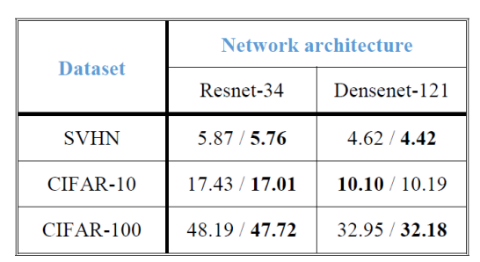
Experiments & Evaluation - Results
Performance measure
Error rate (in %) of the final model on the test set
Average test error is calculated, over 10 runs with different seed
Compare training with mini-batch trimming disabled / enabled
Results
Mini-batch trimming improves generalization capability of trained model in nearly all cases
Except for DenseNet-121 on CIFAR-10
Mini-batch trimming brings also a potential runtime benefit
But only for models without BN layer (e.g. Transformers)

Slide 7


Acknowledgements
The research leading to these results has received funding from the European Union’s Horizon 2020 research and innovation programme under grant agreement No. 951911 - AI4Media
https://ai4media.eu

